Slide 2
Treachery Diagnosis Of Cards And Insurance Claims
Using Python
MENTOR SHEKHAR DIXIT(R133218024)
MR. SHASHI BHUSHAN TANISH PANDEY(R133218026)
ASSISTANT PROFESSOR URVIZA SRIVASTAV(R133218028)
UPES MAYANK KASHYAP(R133218034)
- C.SE-BFSI(VII)

Slide 3
Abstract
This project aims to Predicting the probability of an online transaction being fraudulent and diagnosis of treachery of insurance claims.
We are using kaggle datasets of transactions . The data is broken into two files identity and transaction, which are joined by TransactionID. Not all transactions have corresponding identity information.
For Insurance claims we are using insurance claims dataset from Kaggle.
Through machine learning algorithms, millions of transactions can be searched to spot patterns and detect fraudulent transactions.

Slide 4
Introduction
Card fraud is a term used for theft and fraud committed using a payment card, such as debit or credit card as a fraudulent source of funds in the transaction.
It can be done either by theft of an actual card or by illegally obtaining the cardholder’s account and personal information.
With the help of machine learning we can find the pattern of usual and unusual behavior of a client's transaction in order to block likely frauds.
We build a model that can detect online transactions fraud. The challenge behind treachery diagnosis in machine learning is that frauds are far less common as compared to legit transactions.
We have analyzed treachery on online transactions and Insurance claims on the basis of some features through plotting graphs.

Slide 5
Literature Review
[1] Alejandro Correa Bahnsen, Djamila Aouada, Aleksandar Stojanovic, “Feature engineering strategies for credit card fraud detection”, “Interdisciplinary Centre of security, Reliability and Trust, University of Luxembourg 2016”.
[2] Changjun Jiang, Jiahui Song, Guanjun Liu. “Credit Card Fraud Detection: A novel approach using aggregation strategy and feedback mechanism”. “IEEE Internet of Things Journal. March 2018”.
[3] Imane Sadgali, Faouzia Benabbou, “Detection of credit card fraud: State of art”, “International journal of computer network and information security – November 2018”
Rama Devi Burri et all [1] presented several machine learning techniques to analysis insurance claims efficiently. They also mentioned three ways to transform machine learning techniques into insurance industry.
Pinak Patel et all [2] proposed a fraud detection framework for health care industry. They classified the fraudulent behaviour in two categories period based claim.

Slide 6
Problem Statement
This project intends to illustrate the modeling of a data set using machine learning with Online Card transactions Fraud Detection.
If some kind of fraud happens the card should be blocked immediately.
Model should avoid predicting a legitimate transaction as fraudulent.

Slide 7
Motivation
Card fraud costs consumers and financial companies millions of dollars annually. While the fraudsters continue to come up with new ideas and tricks.
Fraud analytics greatly increase the speed at which insurers are identifying fraudulent claims or potentially fraudulent claims. This is critical in today's economy, especially in cases of workers' compensation (where fraud is increasing).
The fraudulent claims present overpriced and large problem for insurance company leading to billions of dollars of needless expenses per year
Fraud prevention system is saving millions of dollars per year. We want to improve this figure using machine learning algorithms with great user experience.

Slide 8
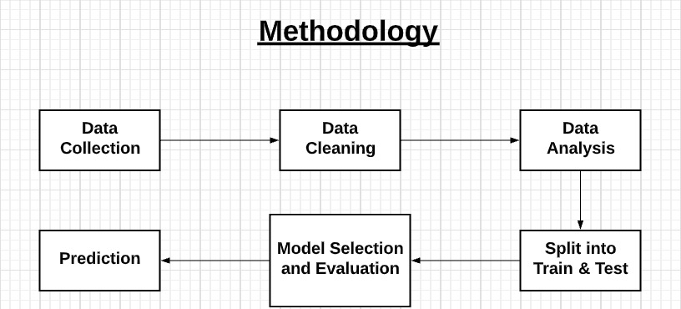
Methodology(1)

Slide 9
Methodology(2)
Question : Why Machine learning in treachery diagnosis ?
Answer :
Machine learning models are able to learn from patterns of normal behavior. They are very fast to adapt to changes in that normal behavior and can quickly identify patterns of fraud transactions. This means that the model can identify suspicious customers even when there hasn't been a chargeback yet.

Slide 10
Methodology(3)
Algorithm used:
Logistic Regression: Logistic Regression is a supervised learning technique that is used when the decision is categorical. It means that the result will be either ‘fraud’ or ‘non-fraud’ if a transaction occurs.
Decision tree : Are used where there is a need for the classification of unusual activities in a transaction from an authorized user. These algorithms consist of constraints that are trained on the dataset for classifying fraud transactions.
LGBM : Light Gradient Boosting Machine is a fast distributed, high performance gradient boosting framework based on decision tree algorithm.

Slide 11
INPUT DATA
The data is broken in two datasets identity and transaction which are joined by TransactionID.
1. Identity Table: (Information about cards and client details)
The Identity Table has 144233 rows and 41 columns.
Variables in this table are identity information – network connection information (IP, ISP, Proxy, etc.) and digital signature (UA/browser/so/version, etc.) associated with transactions.
Features:
DeviceType , DeviceInfo , Id12-id38 ,TransactionID etc.
2. Transaction Table: (Information about the transaction of the clients)
It contains money transfer and also other gifting goods and services, like you booked a ticket for others, etc.
Transaction table has 590540 rows and 394 columns.
Features:
ProductCD, isFraud ,Card1 – card6 ,TransactionID, addr1,addr2, P_emaildomain ,R_emaildomain
We have to merge the identity and transaction data points for our training data.

Slide 12
Implementation(1)
Data Cleaning : Those features which had missing values more than 90% were removed from the dataset because they did not provide any information to our model and they are just garbage which will affect our model’s run time. We filled the missing values with mode values for categorical features and with median for continuous features.
Data analysis : We have done different analysis on data according to different columns like for card transaction we have plotted graph for percentage of fraud by product , company of card ,type of card , type of device and in insurance we are analyzing on count of fraud reported ,incident state , incident date , incident type and gender
Split and test : The dataset has a highly imbalanced class. There are only 3.5 % fraud cases in our dataset and 96.5% non-fraud cases. We have to divide the dataset for train and test in such a way that both the classes are present in the same proportion in both train and test set. For maintaining the same proportion in the train and test set we have used stratified sampling. We are using 70% of the dataset for training and 30% for testing.
Model Selection : For selecting a good model for our problem we first applied different machine learning algorithms and checked for the accuracy of different models on the raw dataset. The model which outperformed all other models without any feature engineering or any special was taken as base model. A complete process and performance of different models is given below.

Slide 13
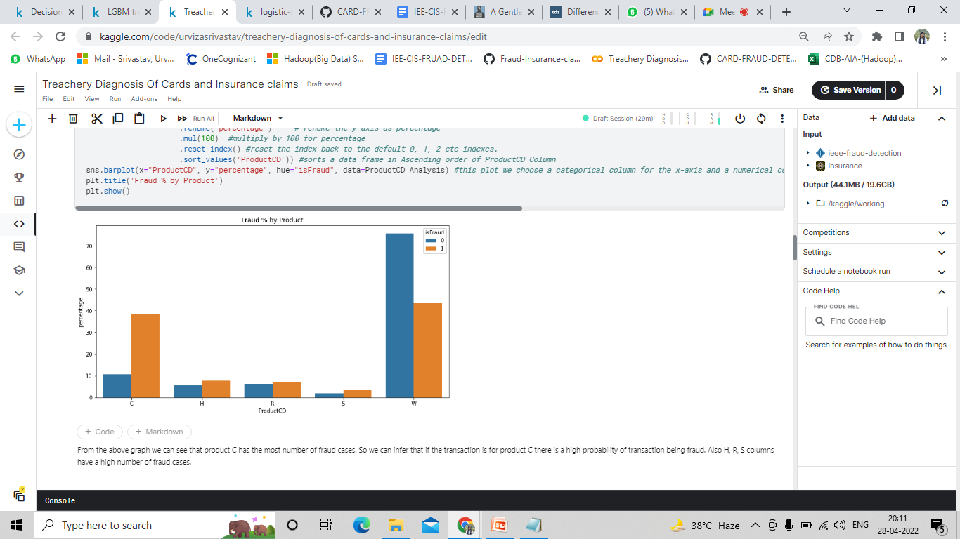
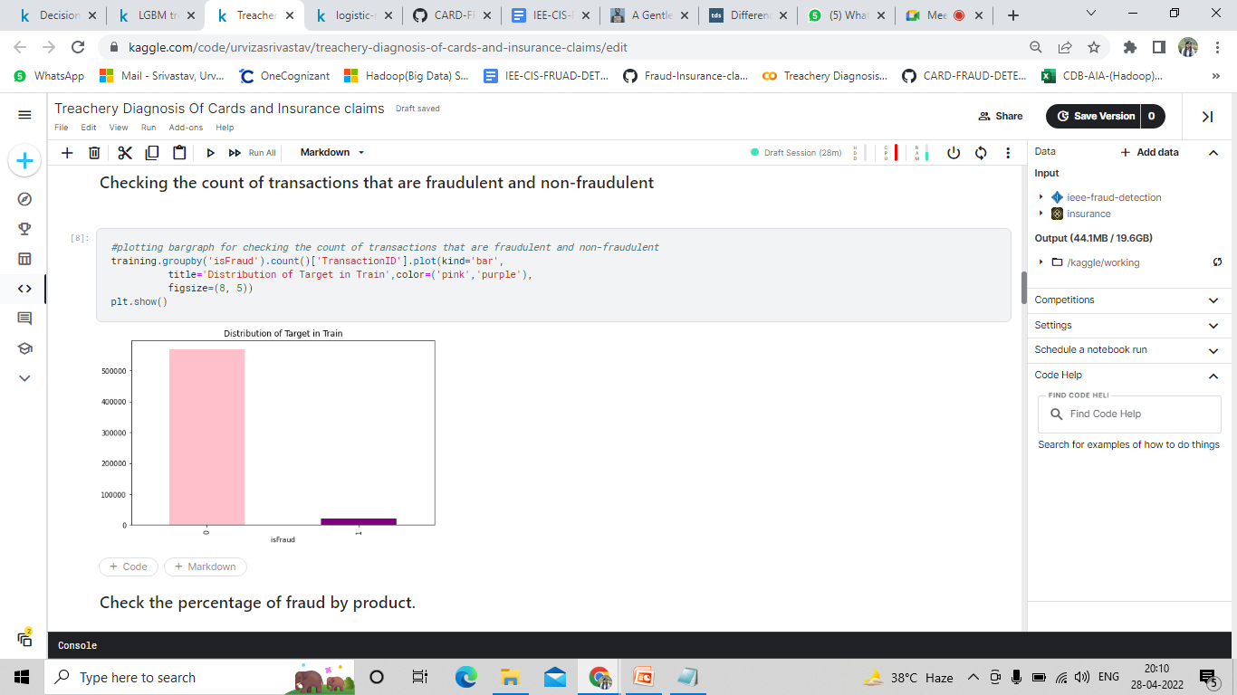
Checking the count of transactions that are fraudulent and non-fraudulent
Check the percentage of fraud by product.

Slide 14
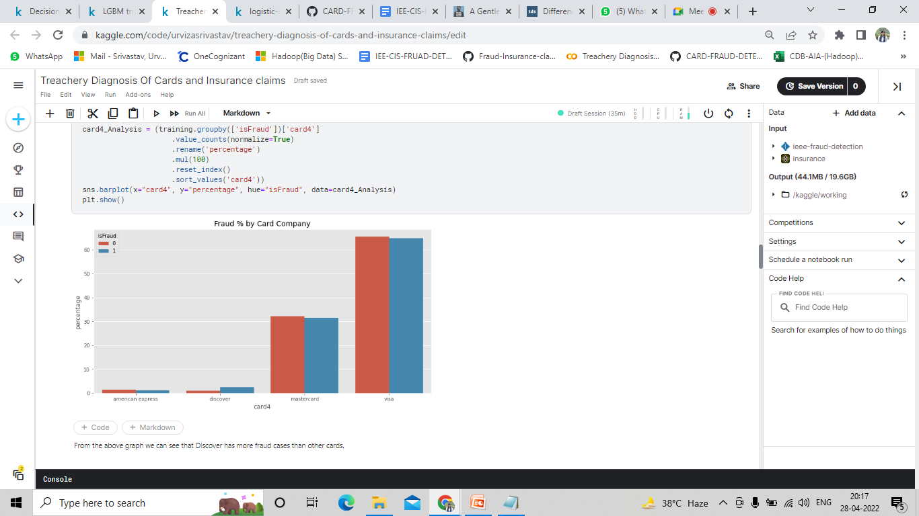
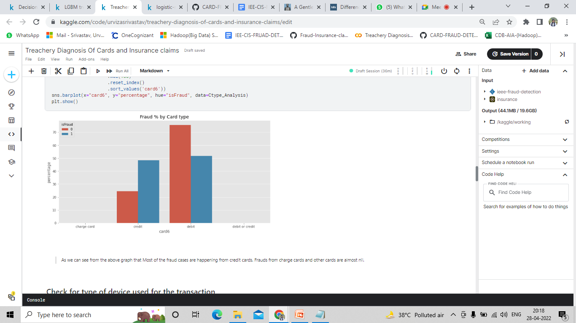
Check the percentage of fraud by card of company.
Check the percentage of fraud by type of card.

Slide 15
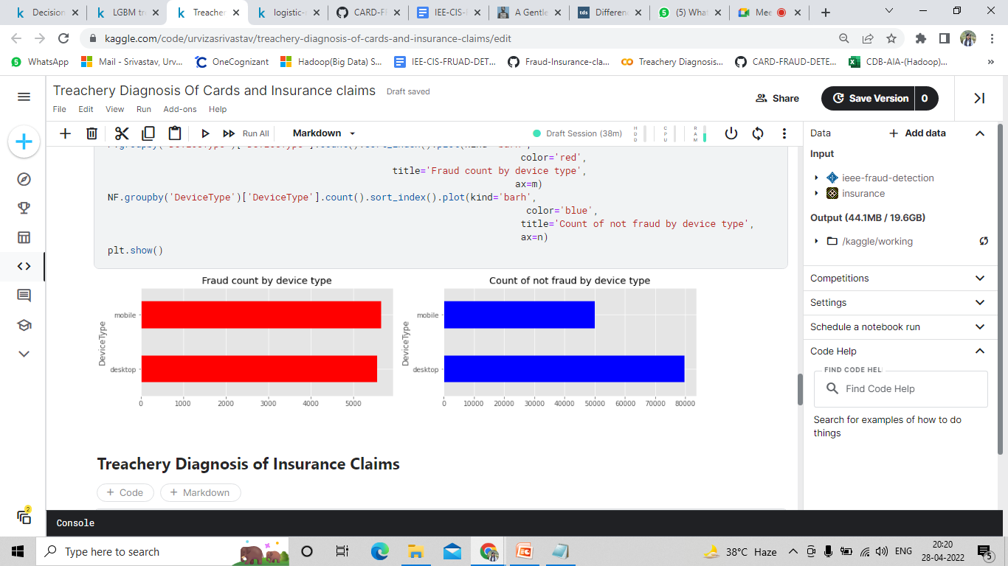
Check the percentage of fraud by type of device.

Slide 16
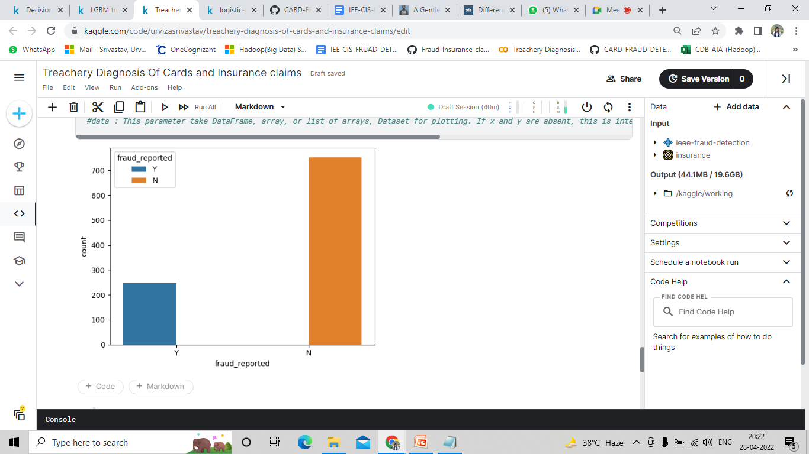
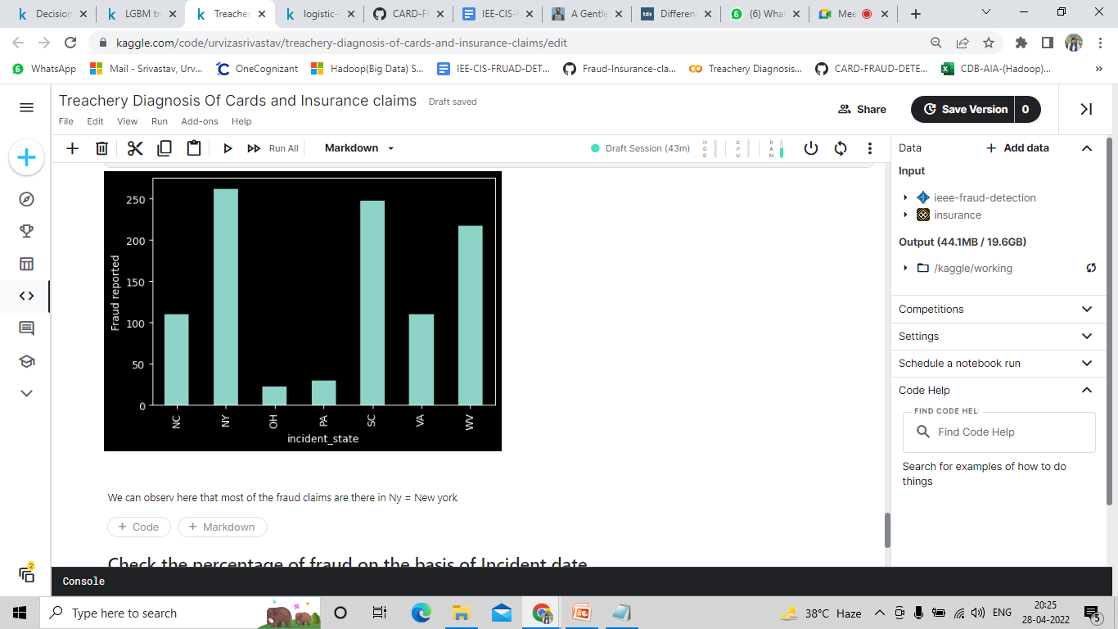
Checking the count of insurance claims that are fraudulent and non-fraudulent
Checking the count of insurance claims on the basis of incident state.

Slide 17
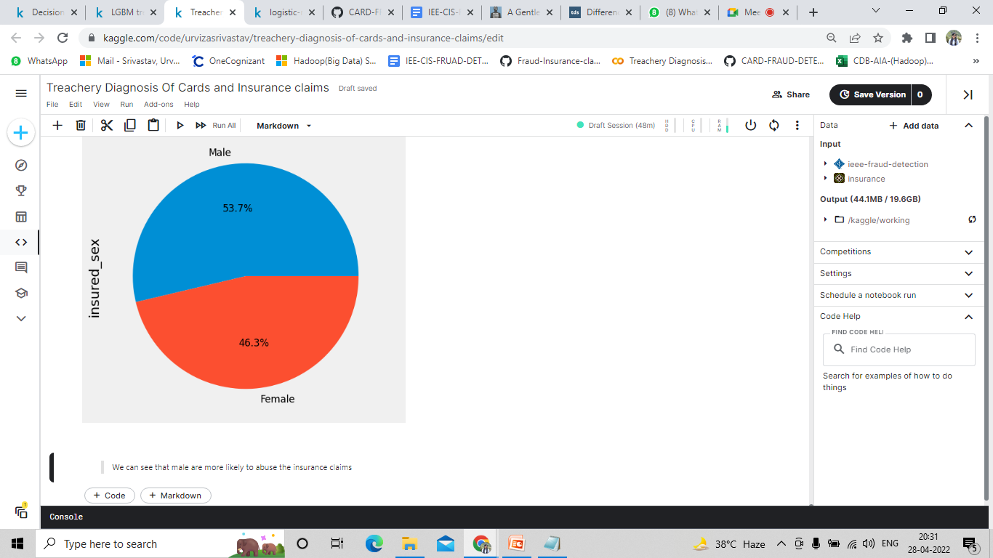
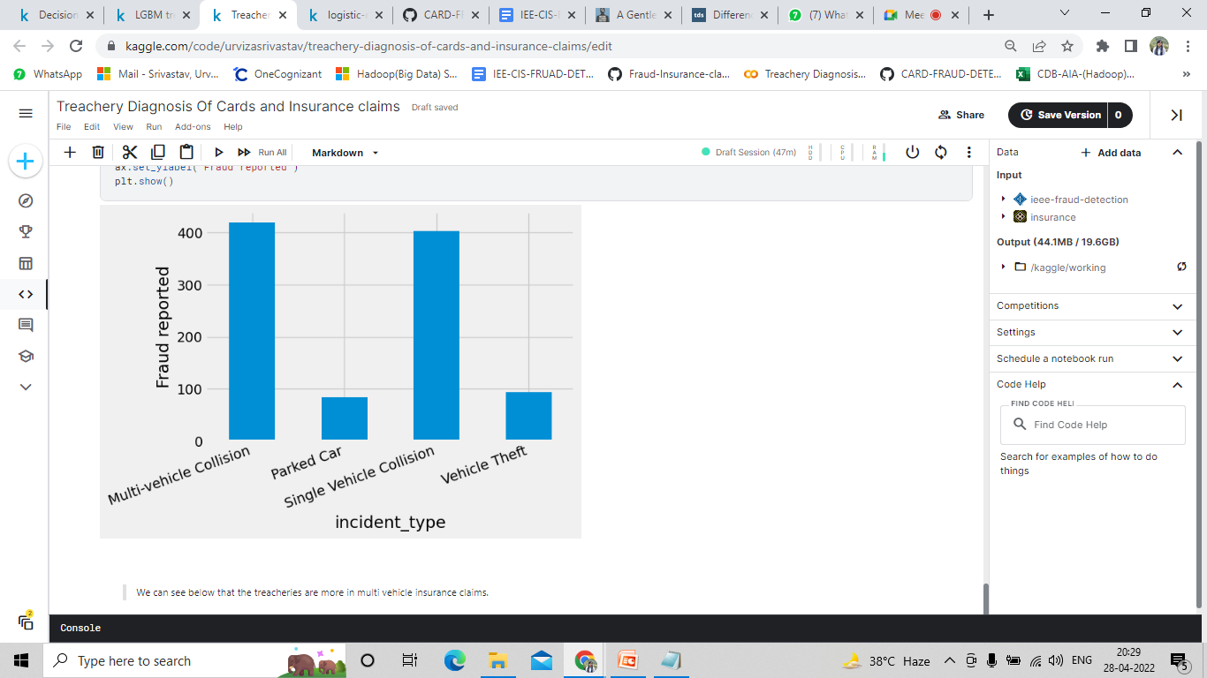
Checking the count of insurance claims on the basis of insured sex.
Checking the count of insurance claims on the basis of incident type.

Slide 18
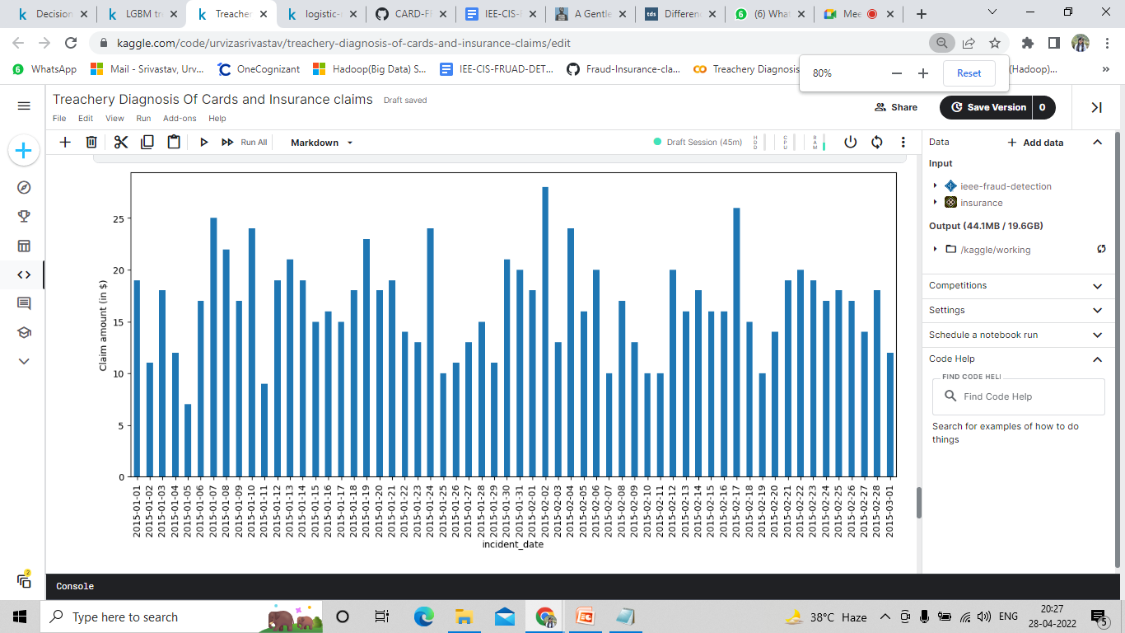
Checking the count of insurance claims on the basis of incident date.

Slide 19
Probability Results
Logistic Regression : After applying logistic regression we only got 0.51 auc_score which is very less. Our main motive was to predict most of the fraud cases as fraud.
Decision tree : We applied a decision tree classifier on our model and got auc_score of 0.78 which is much better then we got in logistic regression. Decision tree performed much better than logistic regression.
LGBM : Using LGBM and with some feature engineering we have build a model that can predict the class of transaction as fraudulent or non-fraudulent with the confidence of 86%
Conclusion
After all the analysis and applying different machine learning algorithms we can say that by using LGBM with all the engineered features we can predict the Class of the transactions as fraudulent or non-fraudulent with 86% of confidence level.

Slide 20
System Requirements
Software Requirements
1. Windows XP ,7, 8, 10
2. Mac OS
Technology Used
Python and its libraries
Google colab
Hardware Requirements
1. Hard Disk – 1 TB
2. RAM – 4 GB
3. Processor – i5 7th Gen & above

Slide 21
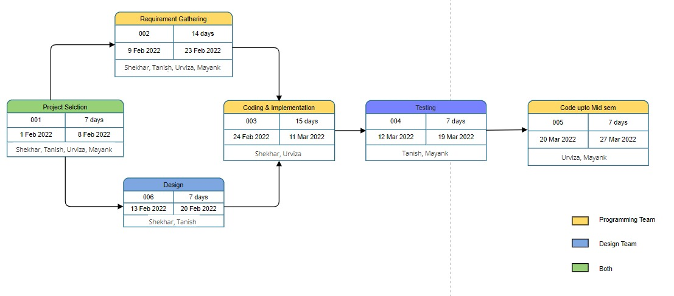
Pert Chart

Slide 22
References
https://colab.research.google.com/drive/1ae8JknF0SwfwrpgY9vHGRPn-e4gsp-GF?usp=sharing#scrollTo=Ygq1xaiX9OUA
https://www.irjet.net/archives/V8/i4/IRJET-V8I4577.pdf
https://www.ijitee.org/wpcontent/uploads/papers/v8i6s4/F11180486S419.pdf
https://www.researchgate.net/publication/337508754_Extreme_Gradient_Boosting_Machine_Learning_Algorithm_For_Safe_Auto_Insurance_Operations
https://www.researchgate.net/publication/336800562_Credit_Card_Fraud_Detection_using_Machine_Learning_and_Data_Science
https://docs.google.com/document/u/1/d/e/2PACX-1vTaHuO1OausEJli70VwXYJQzkVJPbm3mRLqZTUN1Ks-aepcGinko8hcmVCAfXEn1g/pub

